Slide 1
Impulse Excitation Technique
Thermal Shock Testing of Gel-Bonded Magnesia Refractories
Based on Ph.D Thesis, Paul Bosomworth, Leeds University, 1986 Paul Bosomworth President/CEO BuzzMac International, LLC
Contact Info
Email: paul@buzzmac.com
Ph: +1 (603) 835-3180

Slide 2
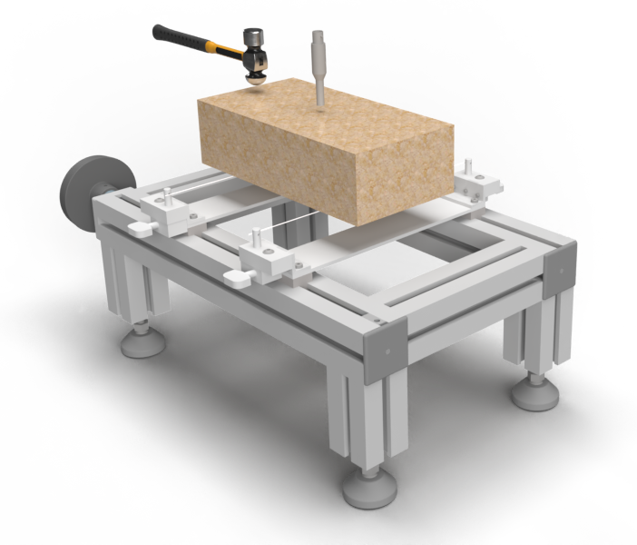
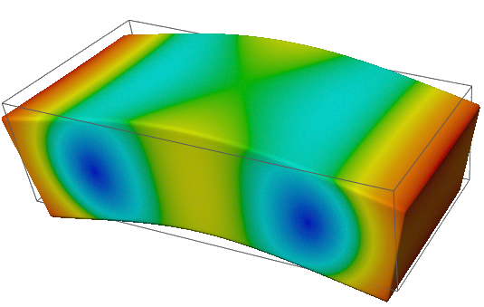
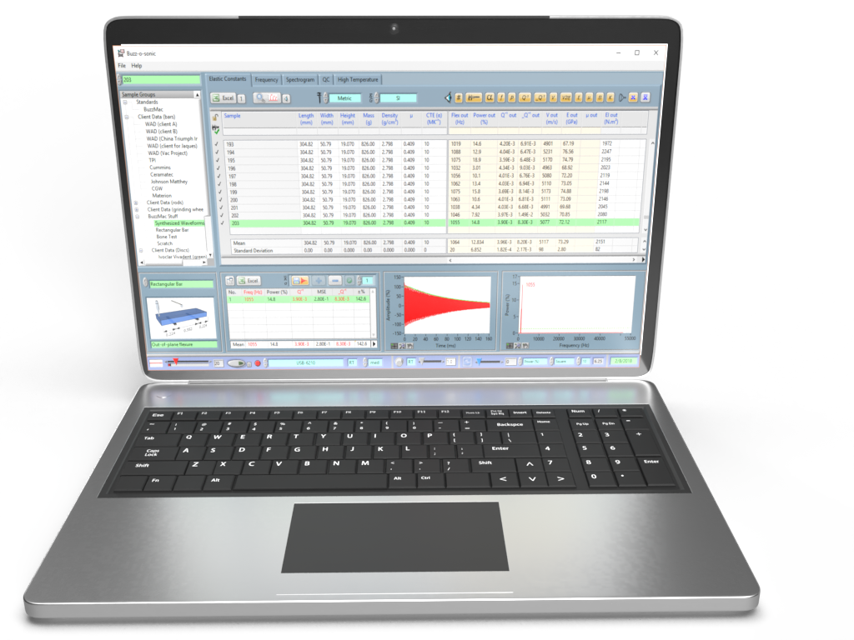
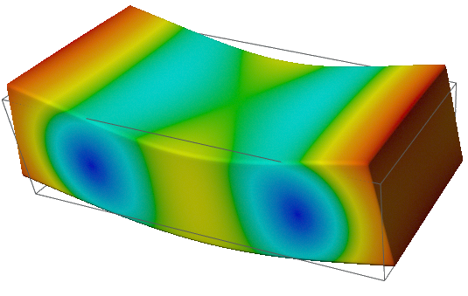
Impulse Excitation Technique (IET)*
TAP BRICK
MEASURE
VIBRATIONS
RECORD & ANALYSE
(damping/elastic properties)
*also known as ping test, resonant vibration, impact acoustic resonance, eigen frequency method…

Slide 3
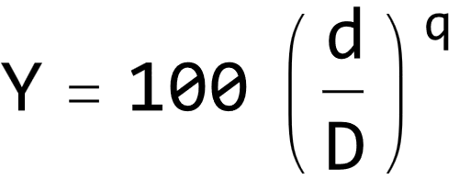
Introduction
The purpose of this study was to reduce the extent of mechanical damage after thermal shock in a series of magnesia refractories (used as inner nozzles materials in sliding gates). The damage was reduced in two main ways:
Using gel-binders to increase the number density of uniform cracks
Using optimum grain packing
Increasing the crack density can be expected to increase the thermal stress damage resistance based on some theories by Hassleman^{1,2}. Rigby³ demonstrated that gel-binders, such as ethyl silicate, create a network of cracks because of the shrinkage of the gel as it converts to silica.
Carswell⁴ showed that the damage resistance could be increased by using fine pore size distributions. Thus, the granulometry of the refractories were based on an optimum packing formula by Andreasen and Anderson⁵ as follows:
D. P. H. Hassleman, J. Am. Ceram. Soc. 52 [11], 600-604 (1969)
D. P. H. Hasselman, “Ceramics in Severe Environments,” pp 89-103, Ed, Q. W. Kriegel and H. Palmour III (1971)
A. J. Rigby, H. G. Emblem, and E. W. Roberts, Trans. & J. Brit. Ceram. Soc. 78, 9-11 (1979)
G. P. Carswell, Trans. Brit. Ceram. Soc. 74 [2], 41-47 (1975)
A. H. M. Andreasen and J. Andersen, "Über die Beziehungzwischen Kornabstufung und Zwischenraum in Produktenauslosen Körnern (miteinigen Experimenten)," Colloid Polym. Sci., vol. 50, pp. 217–228, 1930.
Where:
Y = weight percent of powder passing through a sieve of aperture size d
D = largest grain in the system (~4.8 mm)
q = experimentally determined index giving the optimum packing (0.25-0.45 here)

Slide 4
Gel-binders and Granulometry
A series of gel-bonded, seawater magnesia refractories were water quenched through temperature differences ΔT.
The Young’s modulus (E) was measured afterwards, using a resonant frequency method similar to IET. This Young’s modulus was then used to better quantify the thermal stress damage resistance, thereby allowing the damage resistance to be related to the granulometry and type of binder.
The gel-binders were either ethyl silicate or tetraisopropyl titanate¹. The refractories were labeled as follows:
1. EA1-EA4: gel binder = ethyl silicate
2. TA2: gel binder = tetraisoproplyl titanate
3. PA2: no gel binder = traditional pressed brick
Note: PA2, a traditional pressed brick, was included as this was known to have good thermal stress damage resistance.
The resulting weight fraction of fine grains used (fines) and the mean pore size (water-expulsion method²) in the fired refractories for a given Andreasen index (q) are shown below
Paul Anthony Bosomworth, Anup Kumar Das, Harold Garton Emblem, Kenneth Jones, Edward Wilford Roberts, “Titanate based gel,” UK Pat. 2 111 042 A
J. F. Clements and J. Vyse, Trans. Brit. Ceram. Soc 67 [7], 285-317 (1968)

Slide 5
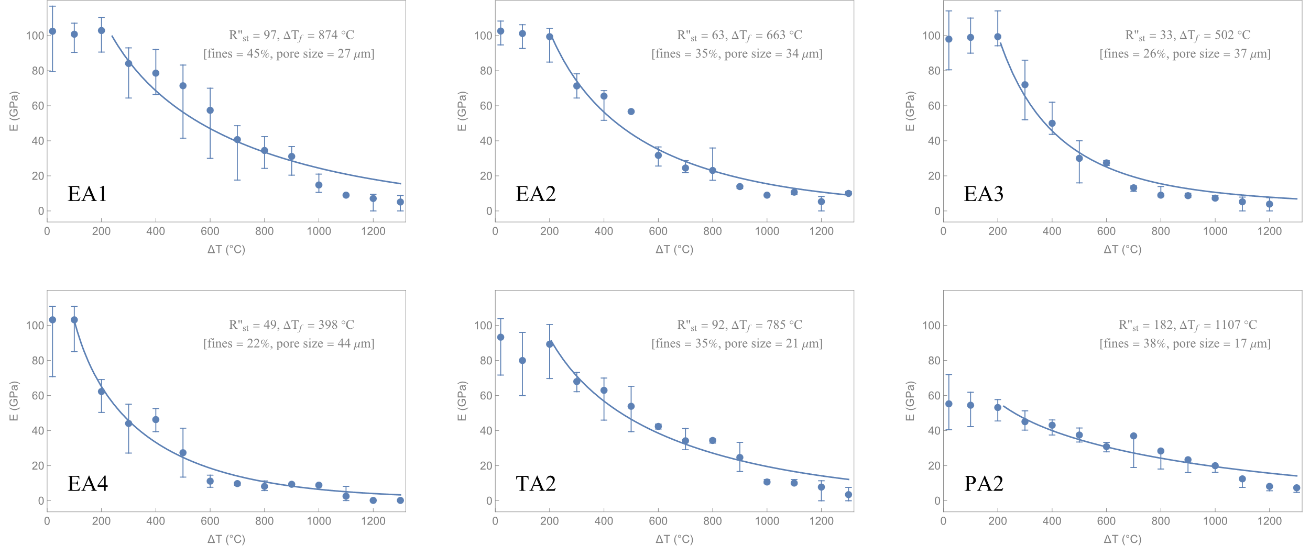
Results
The retained Young’s modulus (E) as measured by IET vs the water quenching temperature (ΔT) are shown below.
Note: R’’_{st} and ΔT_{f} are thermal stress damage resistance parameters derived from a modified Hasselman 2D model. The curves represent the best fits to this model. For more details, contact me on linkedin.com/in/paul-bosomworth-78151514

Slide 6
Discussion of Results
The thermal stress damage resistance, quantified by ΔT_{f}*, correlated highly with the mean pore size, fines fraction, and Andreasen index (q); as shown below.
A disadvantage of using ethyl silicate is that the silica residue reacts with the CaO impurities in the sweater magnesia, forming significant liquid phase during sintering. This causes the fines to agglomerate slightly. The titanate gel-binder forms much less second phase, and so TA2 had much finer pores than the ethyl silicate bonded refractory with the same granulometry (EA2). Thus, TA2 had a slightly higher thermal stress damage resistance. The pressed brick had the highest thermal stress damage resistance because of its smaller mean pore size. However, PA2 had much lower strength than the ethyl silicate bonded refractory of the same granulometry (EA2): 8.8 GPa vs 26.4 GPa. So, TA2 and EA1 had the best combination of properties for the intended purpose (sliding gate nozzle).
* The theoretical quenching temperature to cause complete failure. For more details, contact me on linkedin.com/in/paul-bosomworth-78151514

Slide 7
Conclusions and Comments
IET is ideally suited for measuring the thermal stress damage resistance of refractories
IET can be used over a variety of testing environments (high/low temperatures, humidity…)
IET is fast, efficient and relatively low cost compared to destructive mechanical testing
IET is suited to R&D, QC/QA…
Any question or comments, please contact me on linkedin.com/in/paul-bosomworth-78151514

